Slide 1
Recap lecture 33
Example of trees, Polish Notation, examples, Ambiguous CFG, example,

Slide 2
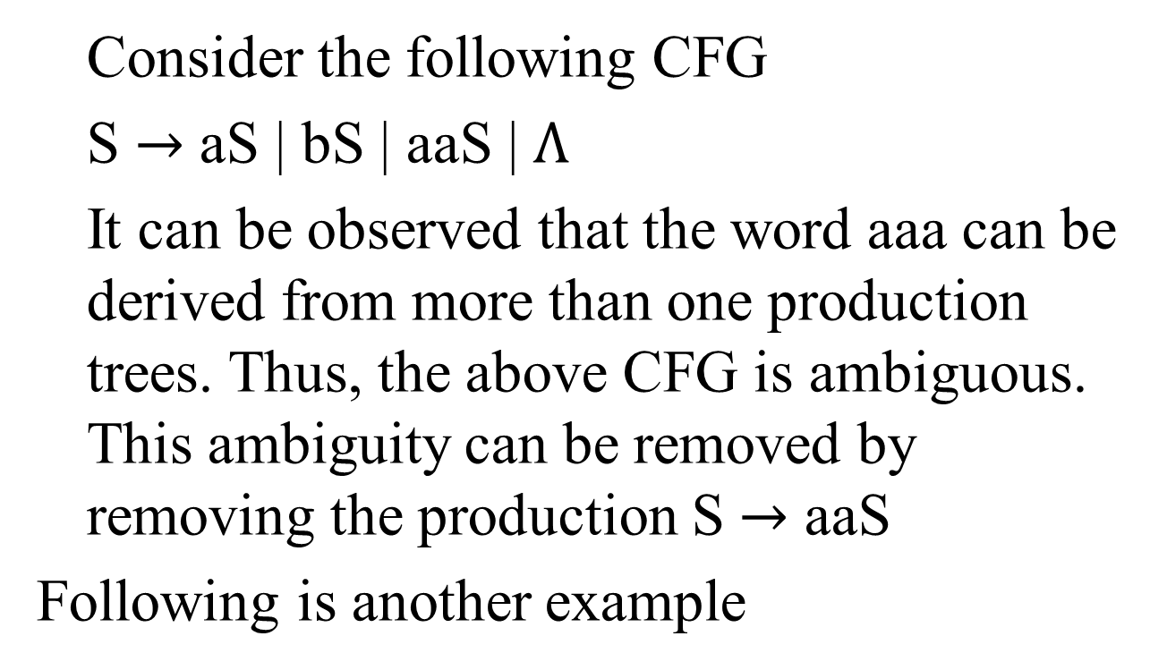
Example
Consider the following CFG
S $→$ aS | bS | aaS | $Λ$
It can be observed that the word aaa can be derived from more than one production trees. Thus, the above CFG is ambiguous. This ambiguity can be removed by removing the production S $→$ aaS
Following is another example

Slide 3
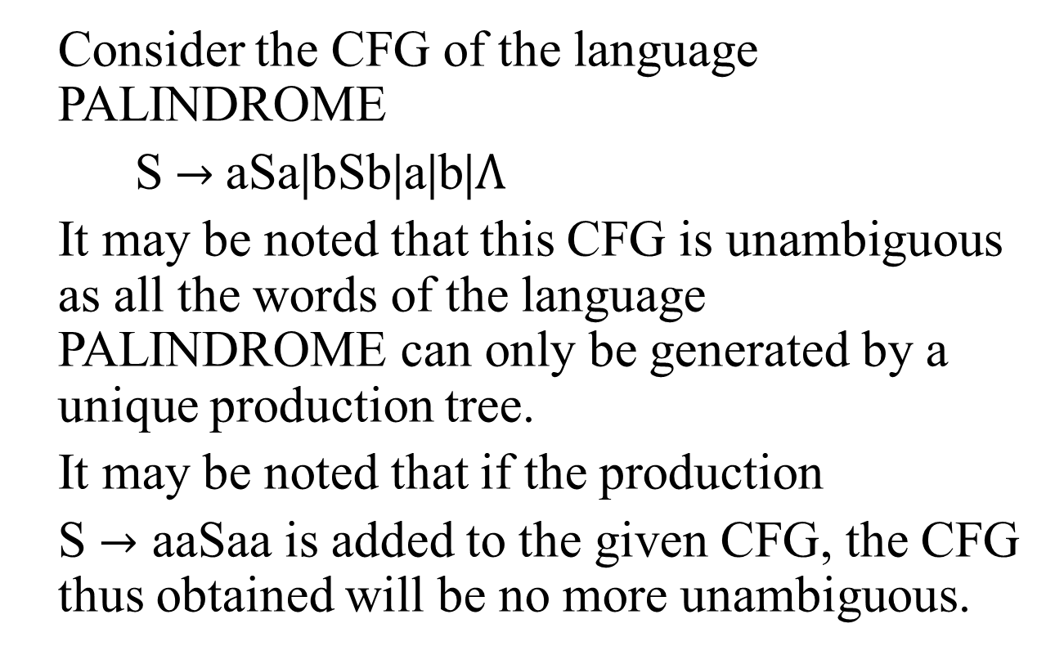
Example
Consider the CFG of the language PALINDROME
S $→$aSa|bSb|a|b|$Λ$
It may be noted that this CFG is unambiguous as all the words of the language PALINDROME can only be generated by a unique production tree.
It may be noted that if the production
S $→$ aaSaa is added to the given CFG, the CFG thus obtained will be no more unambiguous.

Slide 4
Total language tree
For a given CFG, a tree with the start symbol S as its root and whose nodes are working strings of terminals and non-terminals. The descendants of each node are all possible results of applying every production to the working string. This tree is called total language tree. Following is an example of total language tree

Slide 5
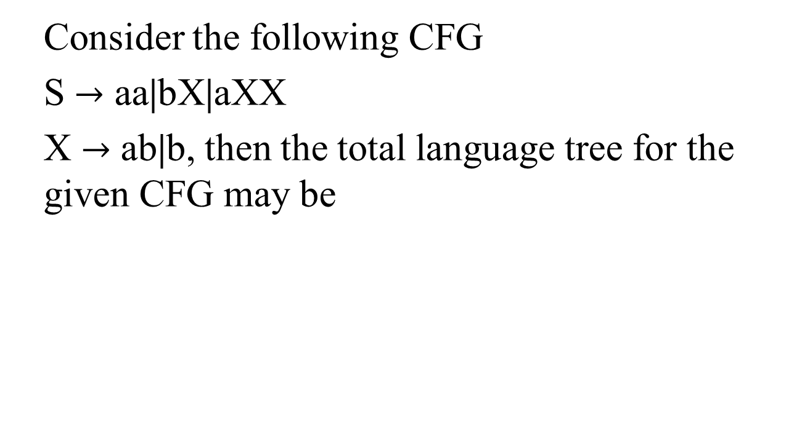
Example
Consider the following CFG
S $→$ aa|bX|aXX
X $→$ ab|b, then the total language tree for the given CFG may be
S
aa
aXX
bX
aXb
abX
abb
bab
bb
aabb
aabX
aXab
abab
abb
aabab
aabb
aabab
abab

Slide 6
Example continued …
It may be observed from the previous total language tree that dropping the repeated words, the language generated by the given CFG is
{aa, bab, bb, aabab, aabb, abab, abb}

Slide 7
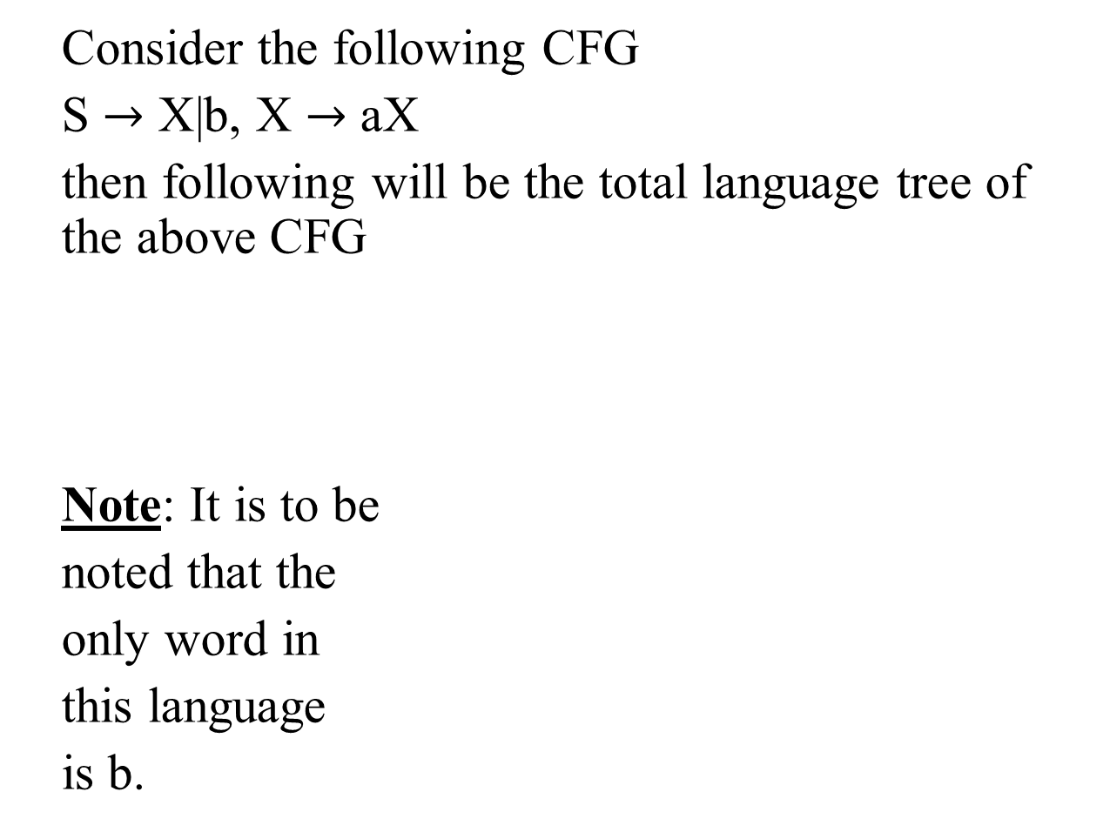
Example
Consider the following CFG
S $→$ X|b, X $→$ aX
then following will be the total language tree of the above CFG
Note: It is to be
noted that the
only word in
this language
is b.
S
X
b
aX
aaX
…
aaa …aX

Slide 8
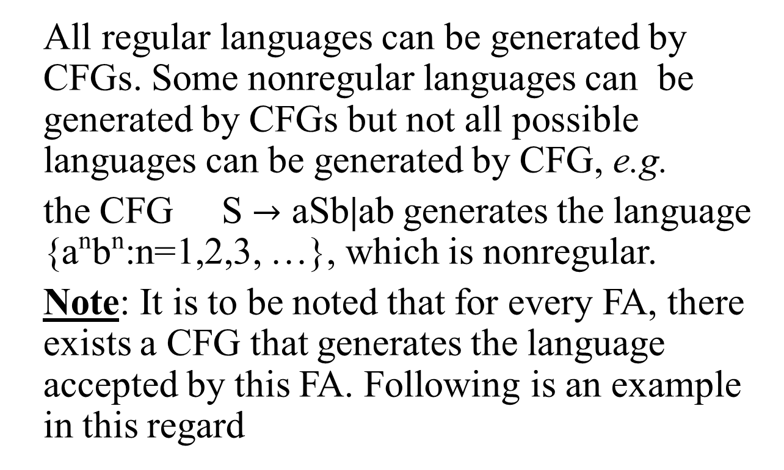
Regular Grammar
All regular languages can be generated by CFGs. Some nonregular languages can be generated by CFGs but not all possible languages can be generated by CFG, e.g.
the CFG S $→$ aSb|ab generates the language {a^{n}b^{n}:n=1,2,3, …}, which is nonregular.
Note: It is to be noted that for every FA, there exists a CFG that generates the language accepted by this FA. Following is an example in this regard

Slide 9
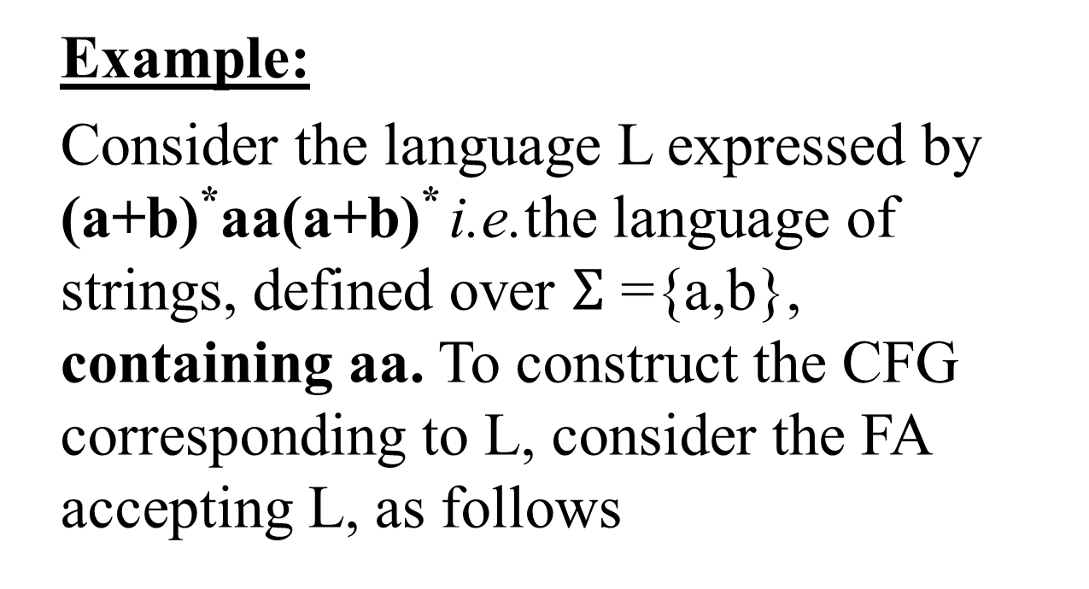
Regular grammar continued …
Example:
Consider the language L expressed by (a+b)*aa(a+b)* i.e.the language of strings, defined over $Σ$ ={a,b}, containing aa. To construct the CFG corresponding to L, consider the FA accepting L, as follows

Slide 10
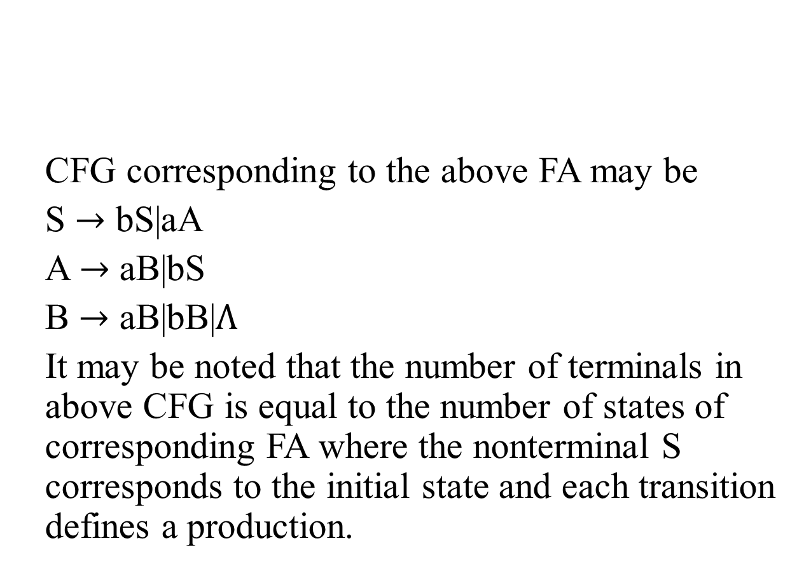
Regular grammar continued …
a,b
b
a
CFG corresponding to the above FA may be
S $→$ bS|aA
A $→$ aB|bS
B $→$ aB|bB|$Λ$
It may be noted that the number of terminals in above CFG is equal to the number of states of corresponding FA where the nonterminal S corresponds to the initial state and each transition defines a production.
A
a
S -
B+
b

Slide 11
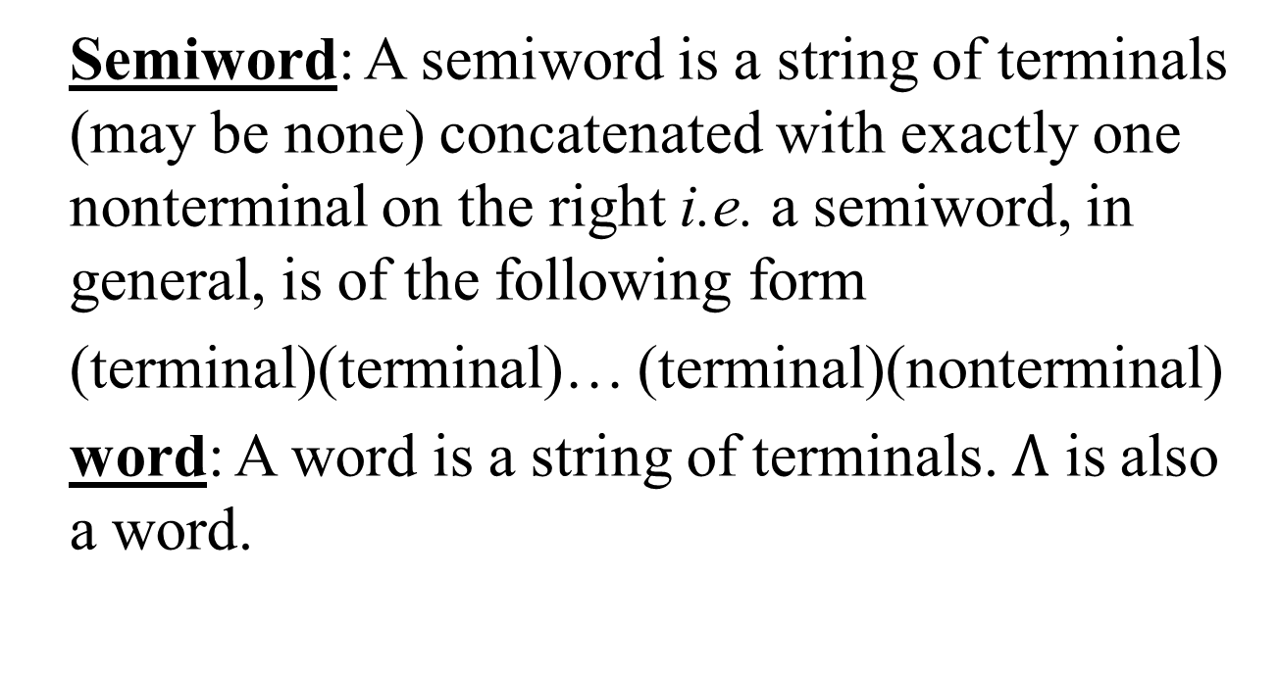
Regular Grammar continued …
Semiword: A semiword is a string of terminals (may be none) concatenated with exactly one nonterminal on the right i.e. a semiword, in general, is of the following form
(terminal)(terminal)… (terminal)(nonterminal)
word: A word is a string of terminals. $Λ$ is also a word.

Slide 12
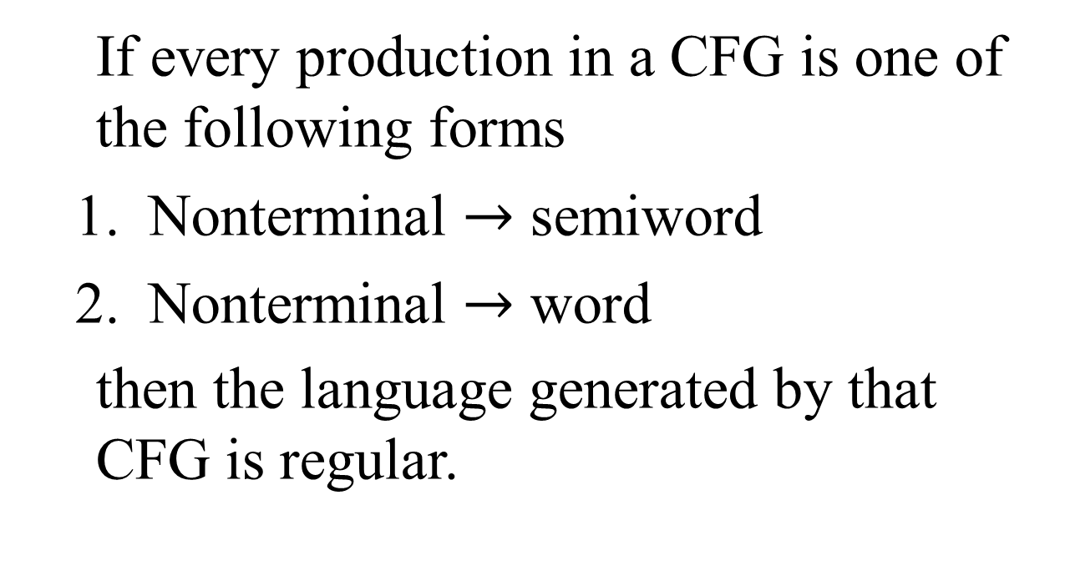
Theorem
If every production in a CFG is one of the following forms
Nonterminal $→$ semiword
Nonterminal $→$ word
then the language generated by that CFG is regular.

Slide 13
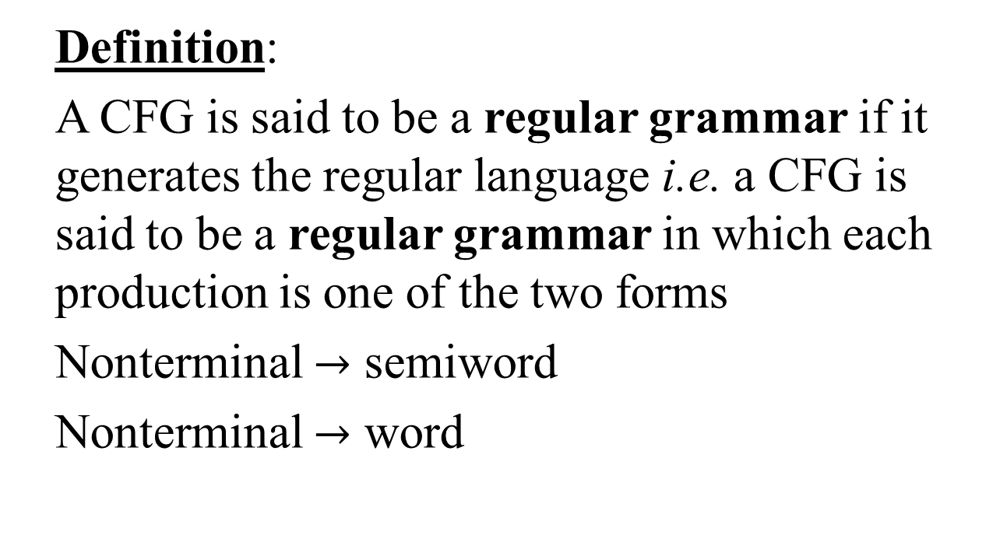
Regular grammar
Definition:
A CFG is said to be a regular grammar if it generates the regular language i.e. a CFG is said to be a regular grammar in which each production is one of the two forms
Nonterminal $→$ semiword
Nonterminal $→$ word

Slide 14
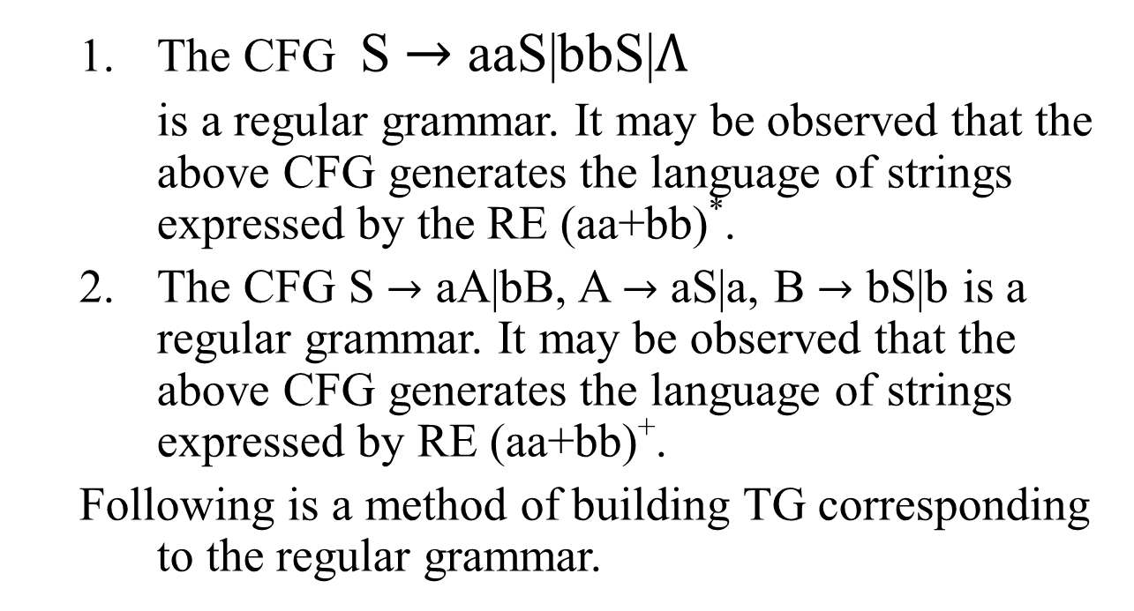
Examples
The CFG S $→$ aaS|bbS|$Λ$
is a regular grammar. It may be observed that the above CFG generates the language of strings expressed by the RE (aa+bb)*.
The CFG S $→$ aA|bB, A $→$ aS|a, B $→$ bS|b is a regular grammar. It may be observed that the above CFG generates the language of strings expressed by RE (aa+bb)⁺.
Following is a method of building TG corresponding to the regular grammar.

Slide 15
TG for Regular Grammar
For every regular grammar there exists a TG corresponding to the regular grammar.
Following is the method to build a TG from the given regular grammar
Define the states, of the required TG, equal in number to that of nonterminals of the given regular grammar. An additional state is also defined to be the final state. The initial state should correspond to the nonterminal S.
For every production of the given regular grammar, there are two possibilities for the transitions of the required TG

Slide 16
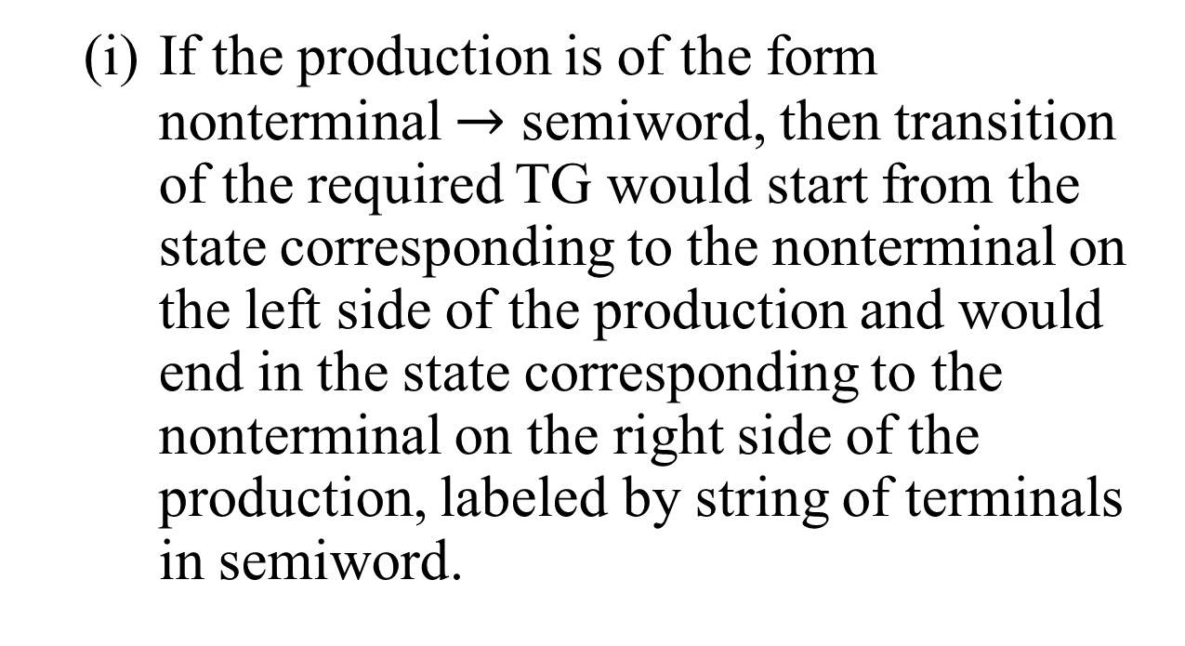
Method continued …
If the production is of the form nonterminal $→$ semiword, then transition of the required TG would start from the state corresponding to the nonterminal on the left side of the production and would end in the state corresponding to the nonterminal on the right side of the production, labeled by string of terminals in semiword.

Slide 17
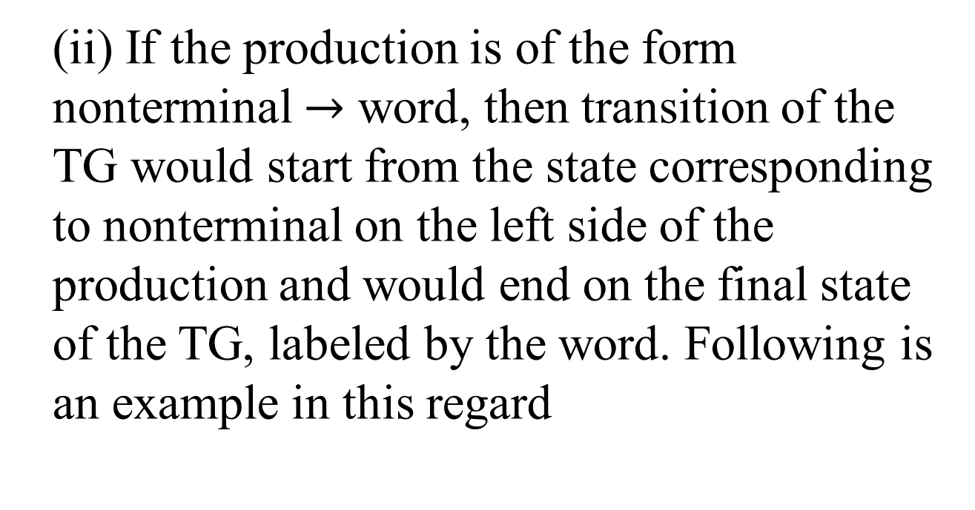
Method continued …
(ii) If the production is of the form nonterminal $→$ word, then transition of the TG would start from the state corresponding to nonterminal on the left side of the production and would end on the final state of the TG, labeled by the word. Following is an example in this regard

Slide 18

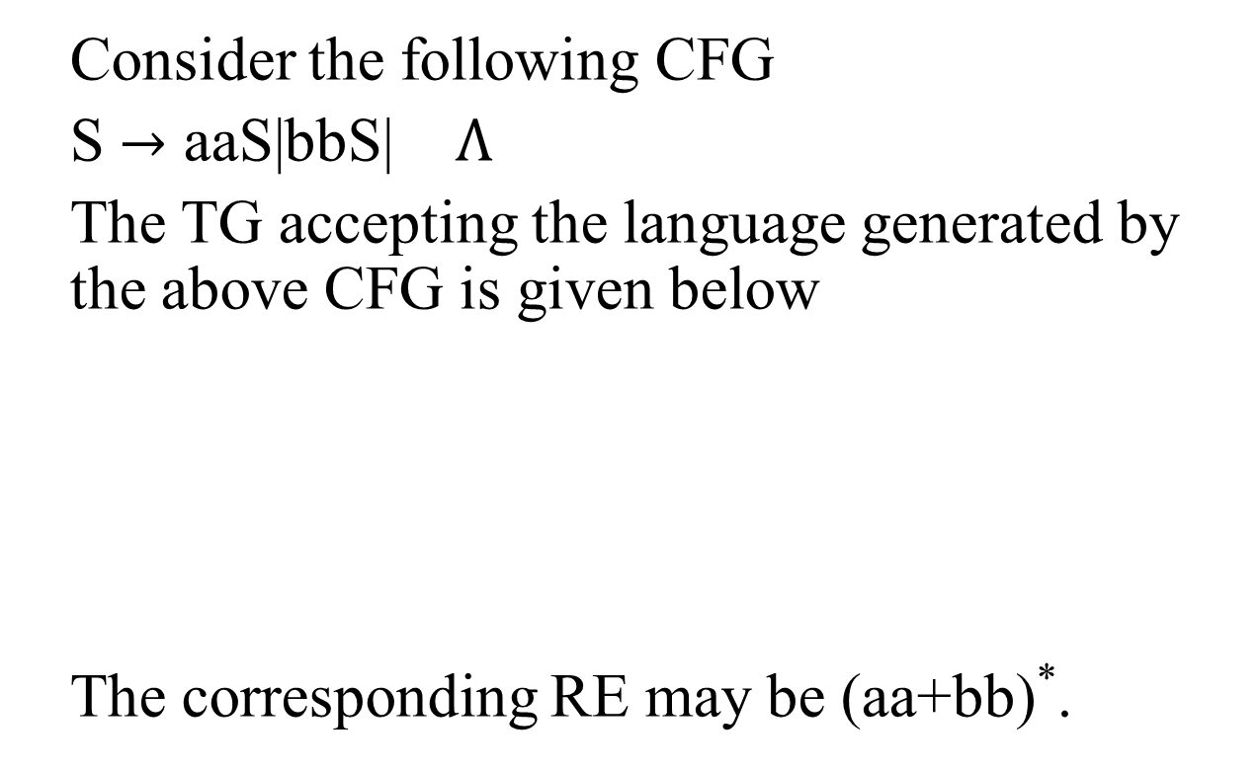
Example
Consider the following CFG
S $→$ aaS|bbS| $Λ$
The TG accepting the language generated by the above CFG is given below
The corresponding RE may be (aa+bb)*.
aa
bb
S-
$$Λ$$
+

Slide 19
SummingUP
Example of Ambiguous Grammar, Example of Unambiguous Grammer (PALINDROME), Total Language tree with examples (Finite and infinite trees), Regular Grammar, FA to CFG, Semi word and Word, Theorem, Defining Regular Grammar, Method to build TG for Regular Grammar

